Slide 1
VRT and the Youth
How VRT radio deals with the young audience
Els Van de Sijpe – Media Manager Radio

Slide 2
VRT and young listeners
1 Radio in Belgium
2 VRT Radio Brands
3 Reaching a young audience
Common grounds
Differences
4 Brand positioning
5 Future listeners: Radio +

Slide 3
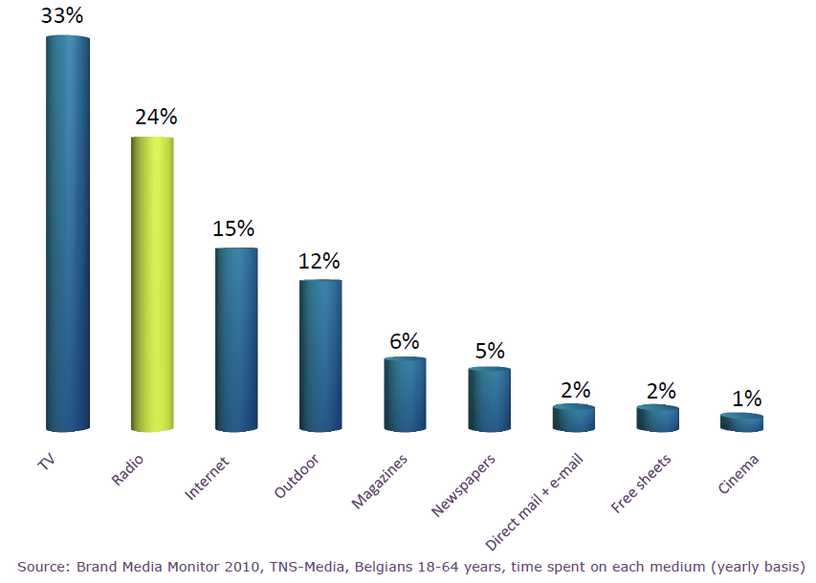
1. Radio in Belgium
2nd most consumed form of media

Slide 4
1. Radio in Belgium
Source: CIM audiometrics, aug ‘12
Notes:
So where are we in the Belgian/Flemish landscape?
VRT Radio = 59, 7% marketshare
5 VRT Radiostations = daily reach of 2.882K listeners
Commercial competitors: main stations
Q-Music = hot ac (25-44) => 15% marketshare
JOE fm = “feelgood” radio (25-55) => 6,4% marketshare
Nostalgie = oldies radio => 7,7% marketshare

Slide 5
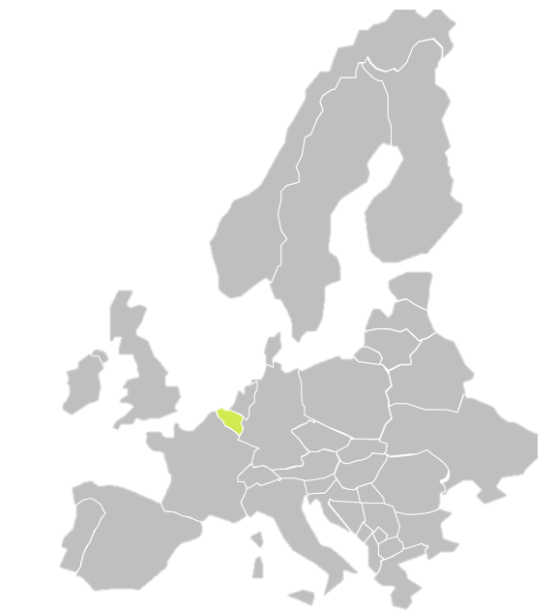
1. Radio in Belgium
Average Time Listening
Ireland 4h 22min.
Belgium 4h 12min.
Netherlands 3h 20min.
Austria 3h 17min.
Portugal 3h 14min.
Finland 3h 10min.
UK 3h 09 min.
Germany 3h 06 min.
France 2h 53 min.
Italy 2h 49 min.
Sweden 2h 23 min.
Denmark 2h 03 min.
Switzerland 1h 53 min.
Spain 1h 47 min.
Norway 1h 40 min.
Source: EBU Guides, July 2012
Notes:
Belgium = second in Europe

Slide 6
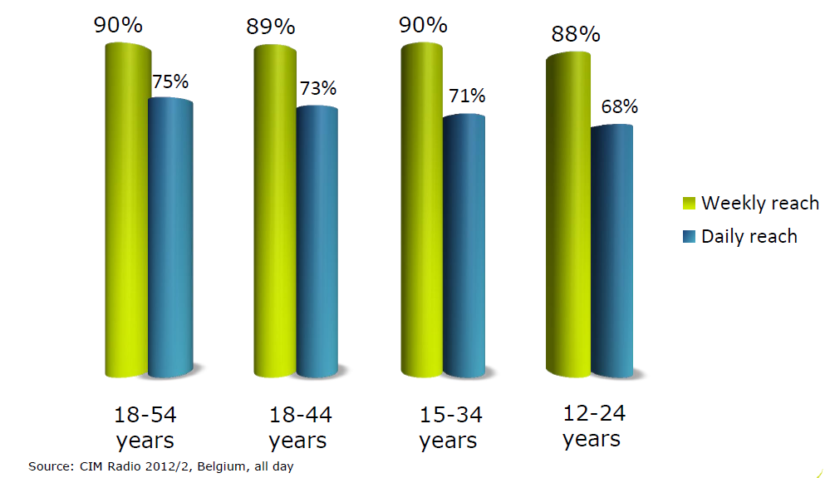
1. Radio in Belgium
Notes:
Strong in all target groups: about 90 procent of all (younger) audience are exposed weekly to radio content.

Slide 7
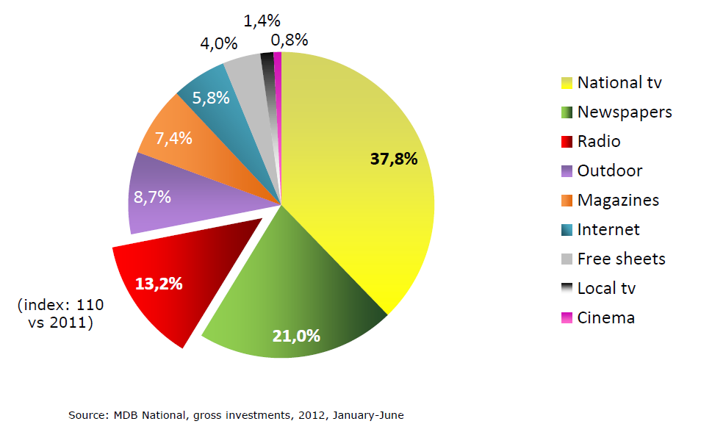
1. Radio in Belgium
Notes:
Radio in Belgium: Still growing in 2012.
Third medium in advertising revenues, after TV and newspapers

Slide 8
2. VRT Radio Brands
current affairs, news & sport
mixed regional and national family radio
classical music, news and culture
join-in hitradio
“young” adventurous music radio

Slide 9
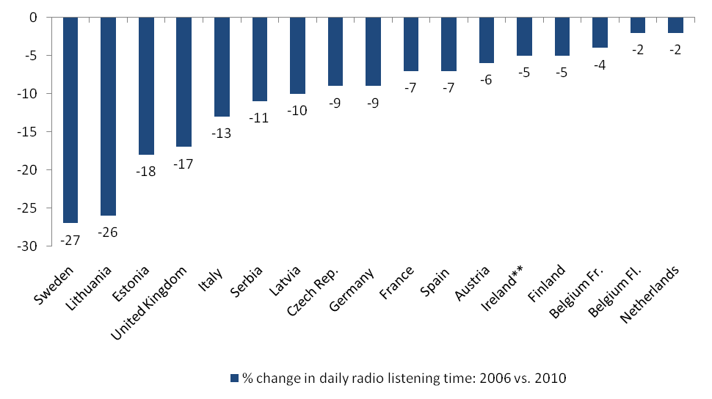
3. Reaching a young audience
Radio listening time is decreasing, especially among youth
**Average weekday listened yesterday (Listened at all, 7am to 7pm)
Source: EBU based on Members’ data
Notes:
Over all, radio listening time is decreasing, especially among youth
Not so much in Flanders (Belgium)
Listening time young listeners remains stable : decrease in other countries

Slide 10
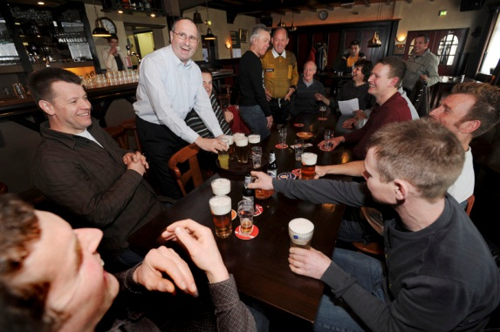
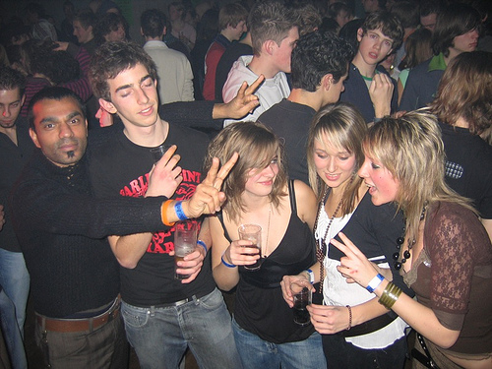
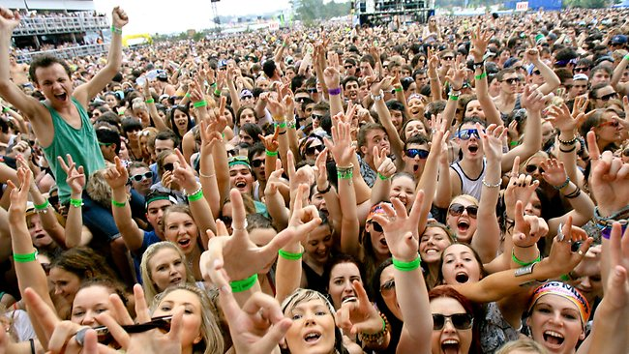
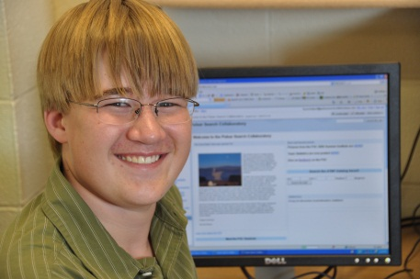
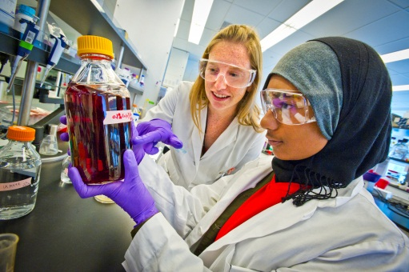
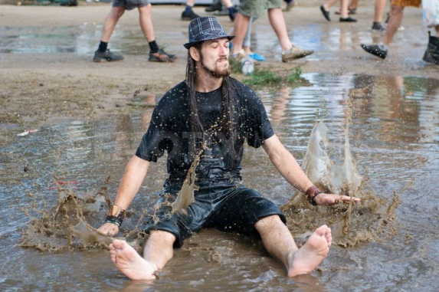
3. Reaching a young audience
Who are these people?
Notes:
→ What do they have in common + what are their differences?

Slide 11
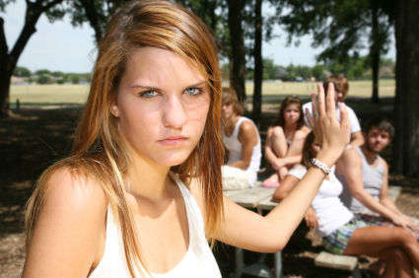
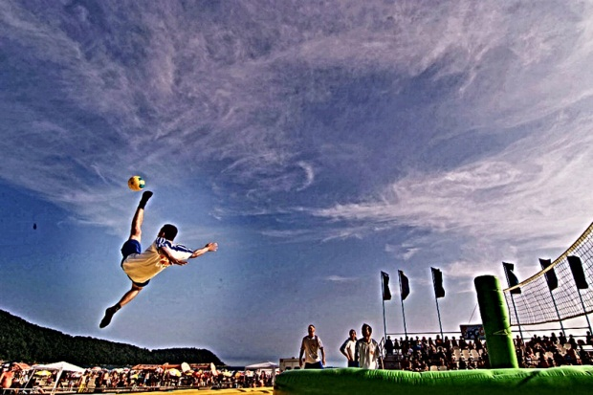
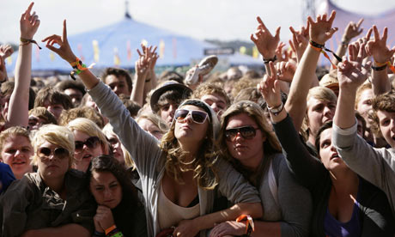
3. Young audience: Common Grounds
Common grounds
Notes:
High social pressure: the need to be successful at school or at work, great deal of materialism
Peer pressure: they feel constantly judged
finding their way in a very serious and demanding world is hard
they need to find ‘their thing’ to be the best at, they want to excell
Real, close friends are scarce, ‘facebook friends’ are numerous
Children of a crisis: a lot of teenage fear and concerns about the future; modest ‘dreams’
Sports or creative hobbies are their favourite way to blow off all this steam.
They’re very ‘tech savvy’: a lot of them have smart phones, they know their way around the internet and social media… they’re digital natives
They’re very passionate about music and fun/entertainment

Slide 12
3. Young audience: MUSIC
Source : PPM-enumeration
Notes:
This graph shows the importance our Flemish youngsters assign to music in their lives:
Nearly 40% of 12-24-year-olds think it’s very importance, and another 40% says it is indeed important to them.

Slide 13
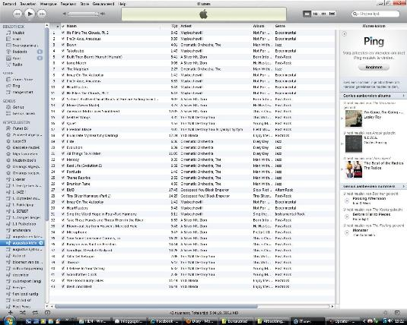
3. Young audience: MUSIC
Change in music consumption
CD Collections → playlists
Music is less tangible, so ephemeral
Music discovery happens online
Favourite genres artists → idols
Notes:
Music is key, but young people don’t treat music like former generations did:
They don’t have record collections, or piles of cd’s stocked up in their rooms, they have it all in mp3 on their computers, they make playlists according to their specific needs, moods or situations
And because music is no longer tangible, but exists only as a computer file, a series of ones and zeroes which can be transferred anywhere in the world in no time, it becomes ephemeral
People don’t buy whole cd’s anymore to discover new music, not even from their favourite artist. They’d rather look around on Youtube or iTunes and click through to new things they might like. And then simply download it.
There’s also a change in their preferences: you used to have people who’d be totally into a certain music genre or devout to a certain artists, but now, youngsters are more ecclectic: they can like certain songs from different genres and artists. But consequently, only the really big names get all the fame.

Slide 14
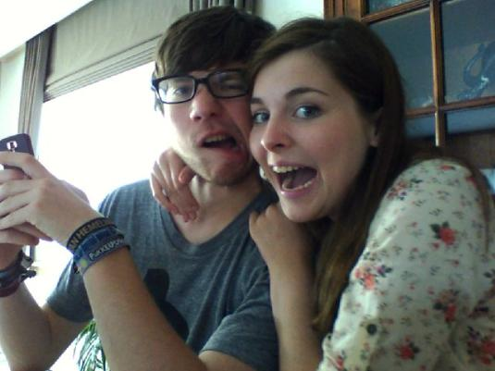
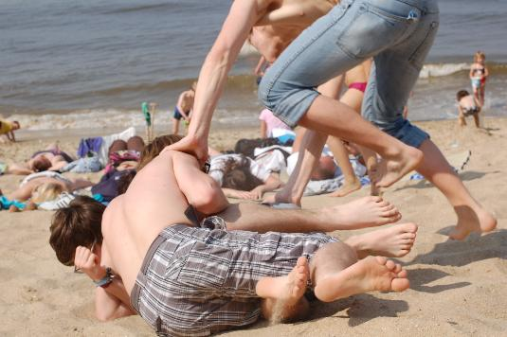
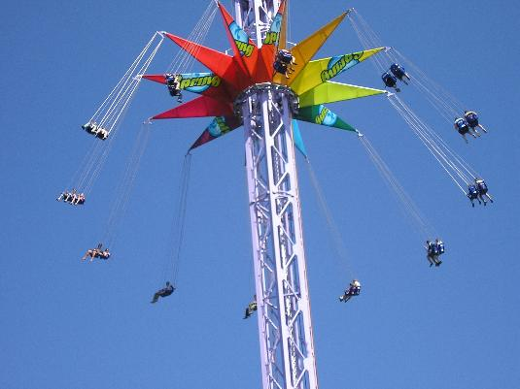
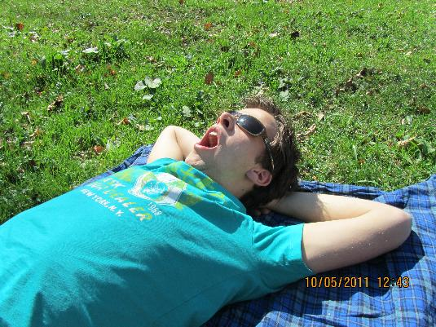
3. Young audience: FUN
Humour
Playing & fooling around
Excitement, kicks
Peace of mind
Notes:
The world is serious enough as it is, we need a good laugh!
Playing is for all ages… Not just video games, but all kinds of outdoor fun as well.
They are looking for excitement: not just kicks and extreme, also inspiring and stimulating experiences
But at the end of the day, they need to let go of their busy lifestyle and kick back

Slide 15
3. Young audience: MEDIA NEEDS
RADIO | light-hearted, funny but social, creative, people with a “twitch”, enjoying life and…music music music
TV | chill, relax, adventure, energy, cosy, obstinate
INTERNET | entertainment and social !
Notes:
In one of our research initiatives (PPM), we were able to ask the target group what they expect of different types of media.
And some definite trends became quite clear about what we should bring to them on an ideal radio, tv and online channel.
But of course, not every young person is the same, so we weren’t about to make one ‘youth’ station, for éveryone, take it or leave it. At least, that’s what some other research told us…

Slide 16
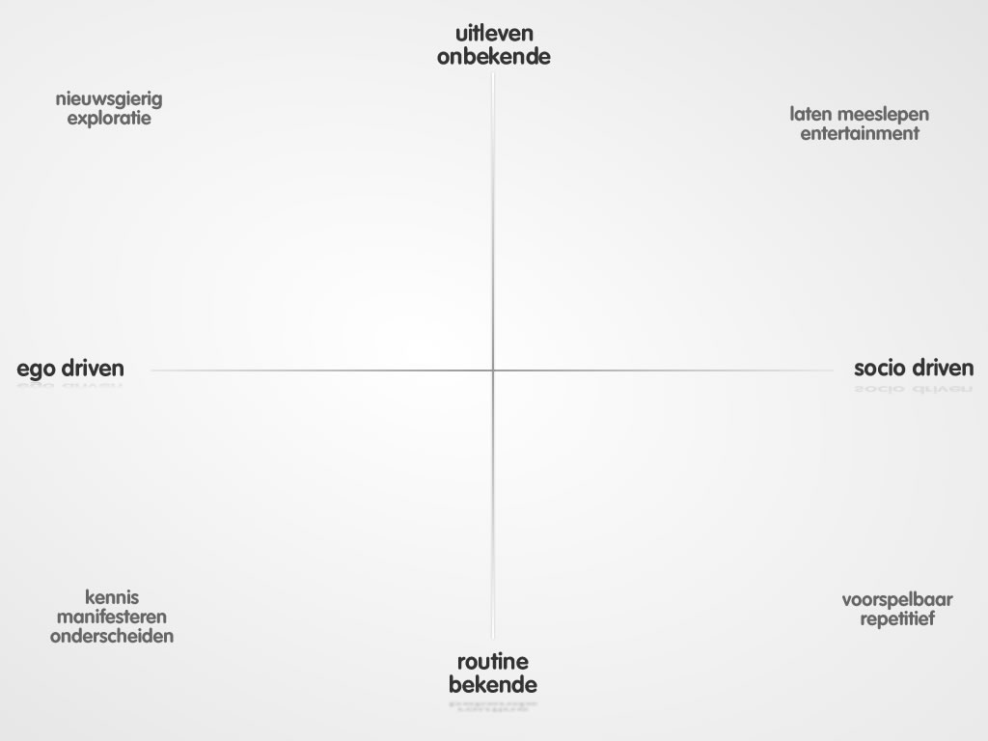
3. Young audience: Differences
Having Fun
Adventure
Enjoying life
Social reliability
Intellect
Security
Notes:
This is our ‘media chart’, it plots the different motivations and thus expectations a person might have when consuming media. We use it to define our target groups and position our brands. There’s a lot of research to back up this rather simplistic view, but let’s assume it basically boils down to this.
Now what did it tell us about youngsters?
It showed that all expect the fun layer, but differentiate in their “surplus” to the fun.
Partially explained by their social context and their phase of life.
For example: a 20 year old worker wants to get a load off when he gets home from work, versus a 20 year old student, who might still look for intellectual stimuli in his spare time. So they’re is a divide, which we could use to position our youth channels and assign some common and some different, or rather ‘complementary’ characteristics to them.
Let’s start on the left hand side.

Slide 17
Individual affirmation
World at my feet
Inner enrichment
Self-actualisation
Progress
Expansion
Studio Brussel encourages an active musical experience as the driving force of an adventurous and peculiar view of the world
MEDIA = CHALLENGING
Notes:
The values of this group of youngsters revolve around freedom and progress:
They are looking for an affirmation of their own distinct identity
They can do something in and about the world, they can make a difference
They want to grow and develop personally
They want to move forward and explore as much as they can
They’re a very ambitious group of people, to which a radio channel needs to live up to.
<click>
It has to be dynamic, open to new ideas, formats, ways of thinking and living. It should also be a platform of self expression, so there is a lot of social interation involved.
Which brings along that the internet and mobile media are very well used: they jump from one medium to another, they want the experience to go on on all channels (for example: if they hear something on the radio that catches their interest, they’ll immediately look it up on internet and start chatting about it on Facebook.
So the content has to be omnipresent and actively keeping up with them!
<click>
Mission Statement:
Studio Brussel encourages an active musical experience as the driving force of an adventurous and peculiar view of the world

Slide 18
Concern
Safety and control
Peace of mind
Fitting in
Escape and relax
… a very approachable and young -join in- station
… relaxing hit radio that focuses attention on the listener and his social environment with a relevant informative offer
Approachable and young ‘inclusive’ station.
Relaxing hit radio that focuses attention on the listener and his social environment with a relevant informative offer.
MEDIA = WELCOMING REASSURING RELAXING
Notes:
Moving to the right side of the ‘media map’: the characteristics of MNM’s audience.
<click>
First of all, whereas the Stubru image is more characteristic to a ‘mindset’ rather than a demographical age group, the MNM ‘state of mind’ is clearly concentrated in younger audiences, mainly teenagers and early twenty-somethings.
They are typically:
Uncertain and, to some extent, concerned about their place in society and their future
Looking for security and control
Looking for peace, in a safe environment like family, sports club
They also don’t want to stand out from the crowd too much. They like to fit in and be accepted.
And as for their entertainment needs: they really like to escape from the harsh world out there and relax without too much intellectual effort or surprises.
<click>
So if we’re starting a radio station that could speak to them, we’d be looking for:
A reassuring, straightforward, easy to digest, somewhat cosy and welcoming channel that offers them an uncomplicated way of relaxing
<click>
=> MNM’s programmes are based on three pillars:
listener sized news and information, social commitment and the promotion of a team spirit.
MNM intends to act as an interactive platform that respects all opinions. Its music attracts young people.
The digital audio streaming MNM hits offers round-the-clock the best hit music and news.

Slide 19
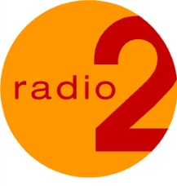
plezier
avontuur
genieten
huiselijkheid
meer weten
vertrouwen
Notes:
This is what the media map and our brand positioning looks like graphically. This way, it is more easy to discern and differentiate the core values for every brand.

Slide 20
4. Brand Positioning: News Bulletins
News and informative needs
Can raise questions |  | Brings answers
Stimulates |  | Reassures
Continuing story |  | Closed endings
Open to ‘new’ stories |  | Hard to reach with the usual offer
Notes:
Of course, this results in a different musical identity for each station, MNM’s play list focusing on pop, dance and urban genres, while Studio Brussel is more likely to explore rock, electronic and alternative genres.
But there’s another difference we saw, namely in the need for and the reception of news and information.
For Stubru audience: our offer of current events can be an ongoing story, that leaves some questions open and stimulates the listerener to think about what’s happening and form his/her own opinion. If they’re interested, they’ll try to further inform themselves immediately on line. So they’re not scared off by ‘new’ items.
For MNM, it was about bringing answers, taking away uncertainty whether the listener is ‘up to date’ on the most important current affairs.
News bulletins are a collection of stories that don’t have open endings, the listener needs to feel that he/she knows enough to get the full picture.
Because the traditional news content and formats don’t really appeal to this specific audience, the MNM bulletins have to focus on the relevance to their listeners, e.g. specialists as well as the reactions of people in the street, tesimonials… and how it resonates in the community.

Slide 21
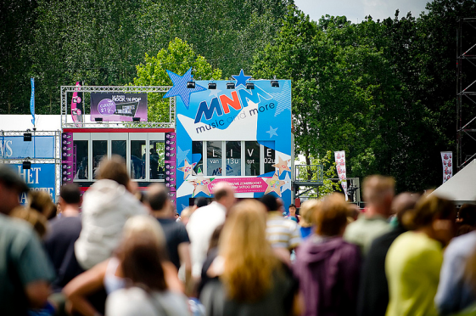
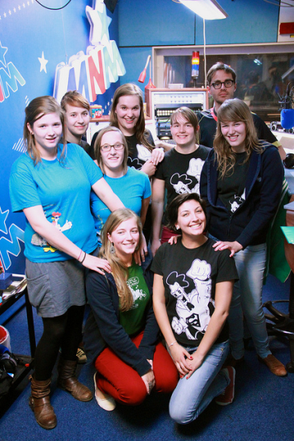
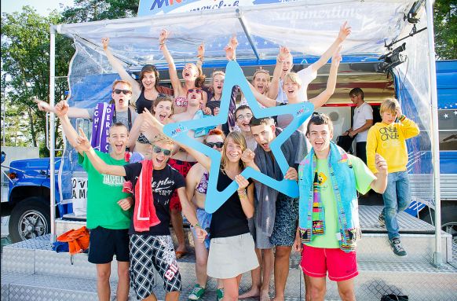
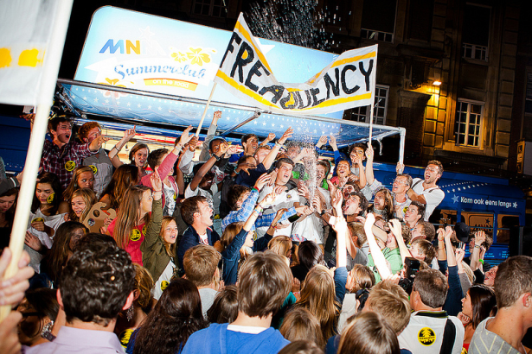
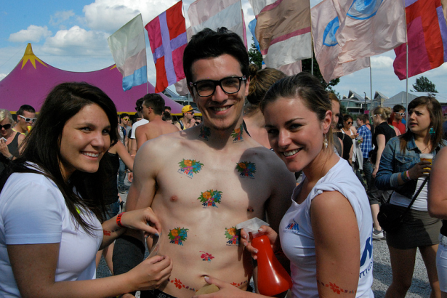
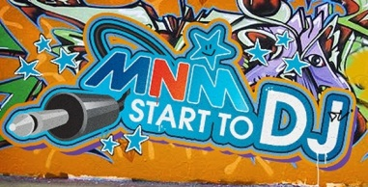
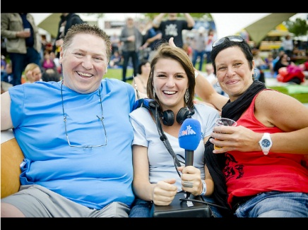
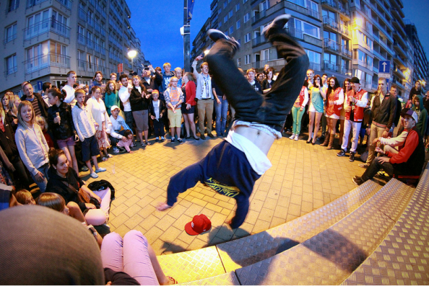
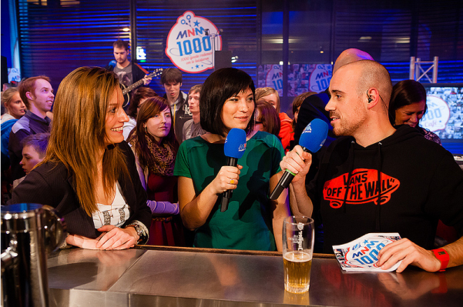
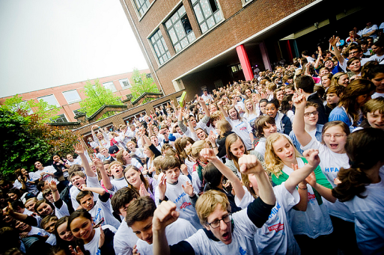
4. Brand Positioning: Events
Notes:
MNM Initiatives:
Start to DJ: A DJ contest during the summer tour. To give one example: next to air time, one of the winners even got to a support act to David Guetta.
Summer festivals: MNM went out to some big festivals
De Strafste School: engaging school communities in search of the ‘coolest school’ in Flanders
EDL:

Slide 22
Marathon Radio
Notes:
Marathon Radio: DJ Peter Van de Veire on air for 185 hours on end… Right in the middle of the exam period, so supporting the students and giving them a ‘fun’ companion while studying or during their breaks. During these 8 days he only slept for 8 hours. Over 2 million listeners tuned in to the show at one point or another.

Slide 23
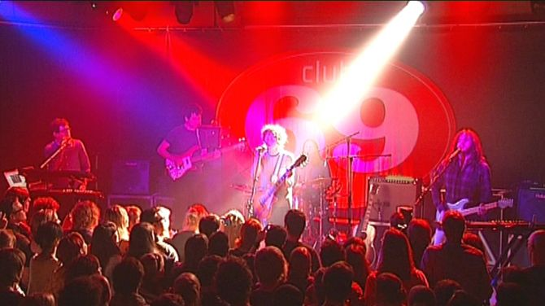
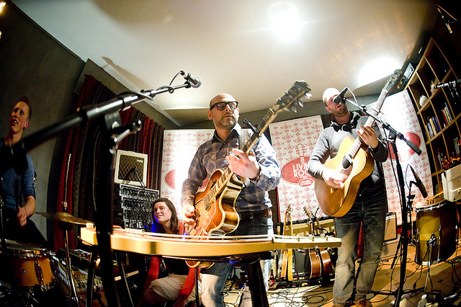
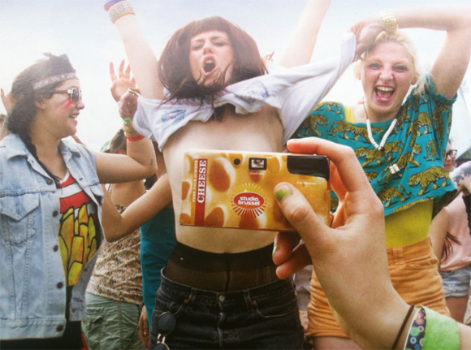
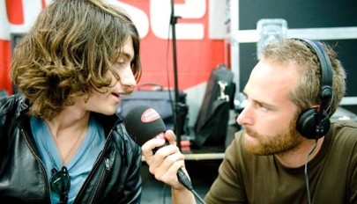
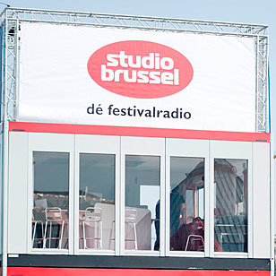
4. Brand Positioning: Events
Notes:
Stubru Initiatives:
Club 69, ‘All Areas’, ‘Living Room’
Mashtag: when they reached their 100.000th follower on Twitter, they started a contest on twitter, with the hashtag ‘mashtag’: everyone could send in their best song music title mashups. The winner could be able to physically follow Studio Brussels everywhere they went (on festivals, club concerts

Slide 24
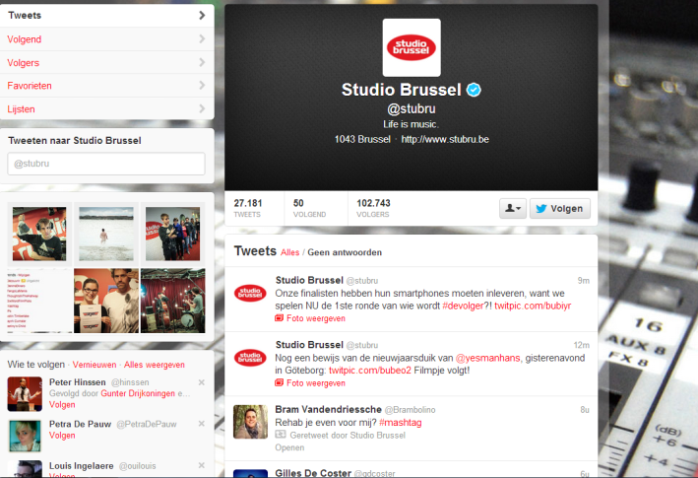
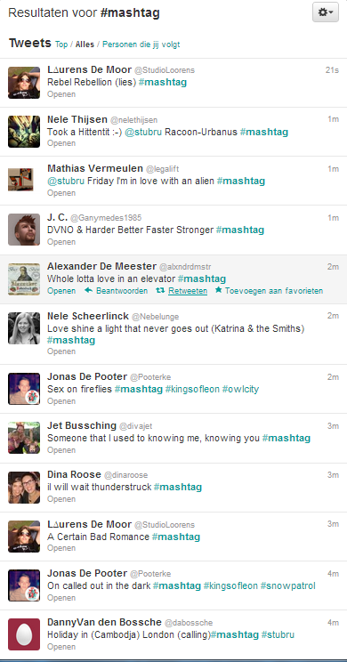
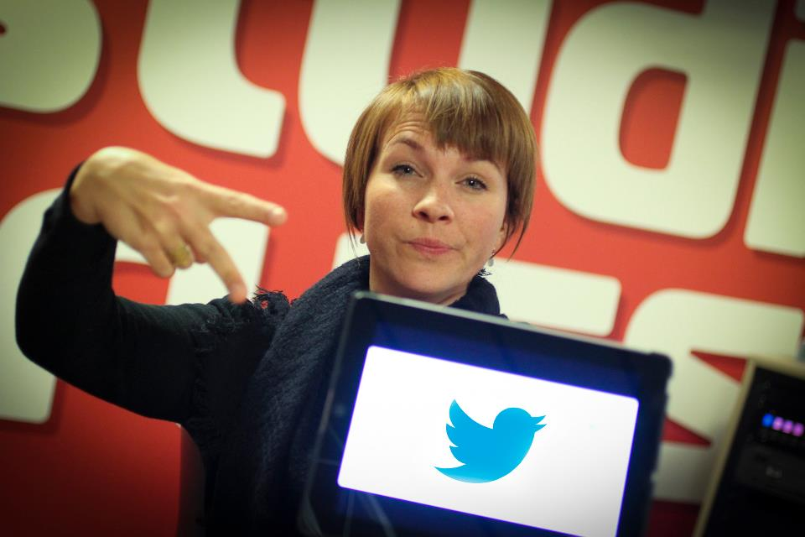
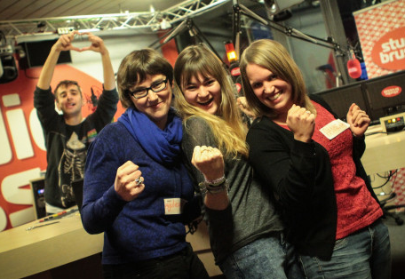
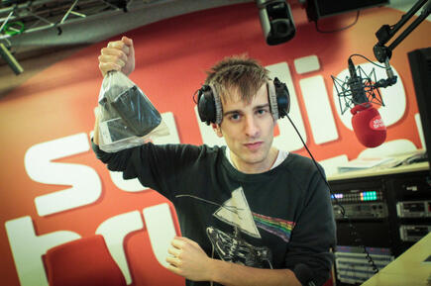
4. Brand Positioning: Events
#mashtag
Notes:
Stubru Initiatives:
Club 69, ‘All Areas’, ‘Living Room’
Mashtag: when they reached their 100.000th follower on Twitter, they started a contest on twitter, with the hashtag ‘mashtag’: everyone could send in their best song music title mashups. The winner could be able to physically follow Studio Brussels everywhere they went (on festivals, club concerts)
! Klik gelijk waar op slide voor audiofragment !
! Klik nogmaals voor start animatie

Slide 25
Music For Life
Notes:
Music For Life: this was born from the ‘Serious Request’ concept, like you have here. For several years, we also did a huge fundraising event around christmas, with a glass house and everything, but this year, we’ve opted for a totally different approach. Rather than raising money, we wanted to raise awareness for dementia, which is becoming a really big problem in society. -> video

Slide 26
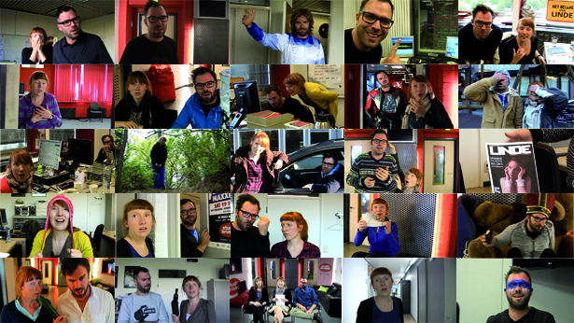
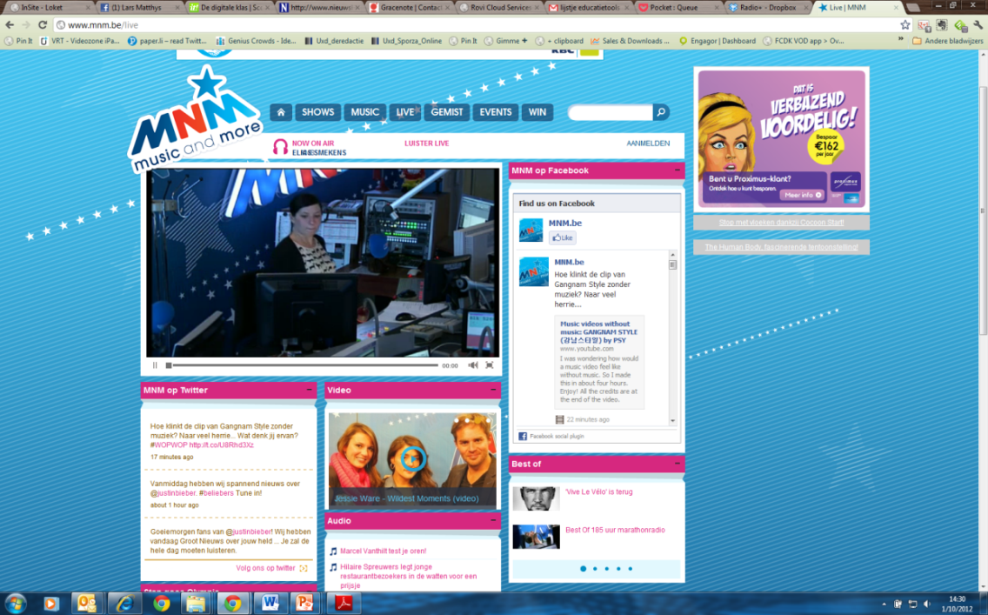
5. Reaching a future audience
Radio
Online
Tv
Social networks
85K likes
26K followers
360°
Radio
Online
Tv
Social networks
250K likes
100K followers
Notes:
Stubru very active online: live streams of studio; successful vlog series
250 000 followers on Facebook, they’re the top listed Belgian media brand on Facebook (source: Socialbakers.com)
they just went over a 100 000 followers on Twitter
MNM likewise, they are currently focusing on extra non-radio content for their web site.
So we’re not just building radio stations, we’re building
<click>
360° brands
Who reach out to their audiences on all platforms, no matter where they are

Slide 27
5. Reaching a future audience
Some Trends
Battle for the radio experience
Software (apps) is the new hardware
Context is paramount
Radio as Companion
Visual culture
Radio is listening and watching
On trigger (on demand)
Claiming music discovery?

Slide 28
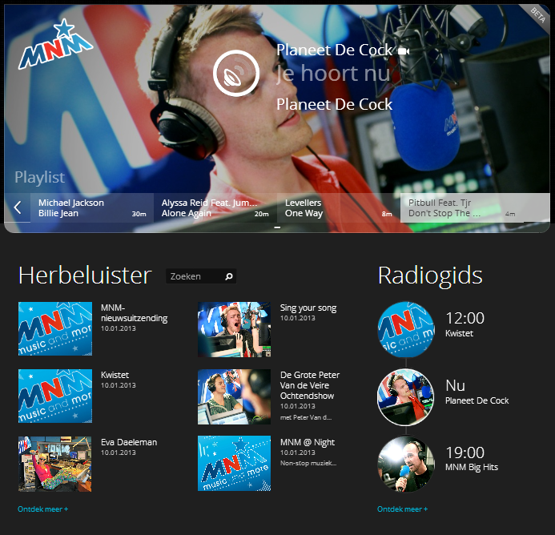
5. Reaching a future audience
Radio +

Slide 29
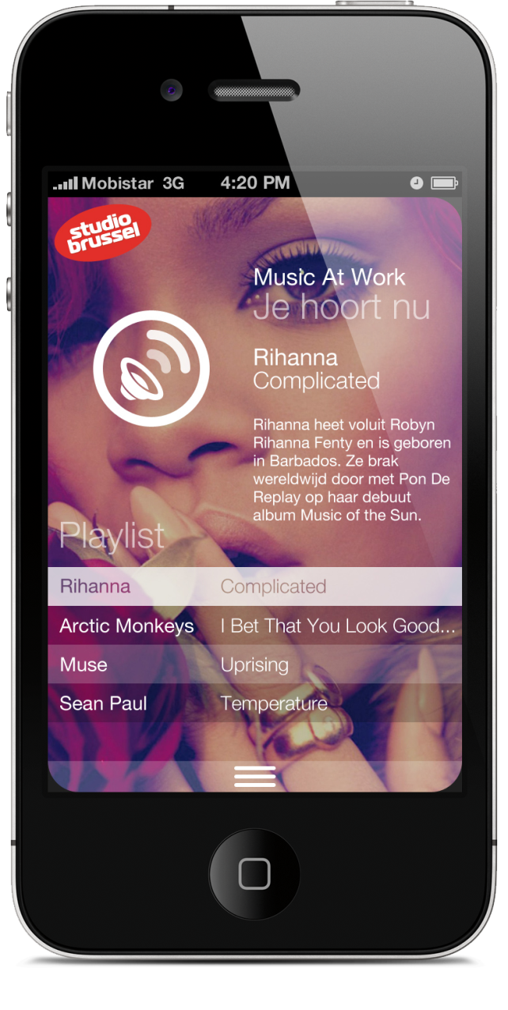
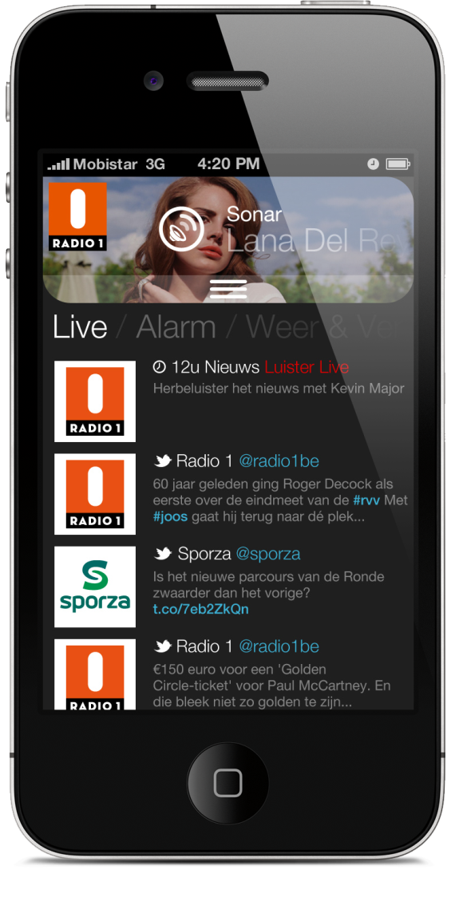
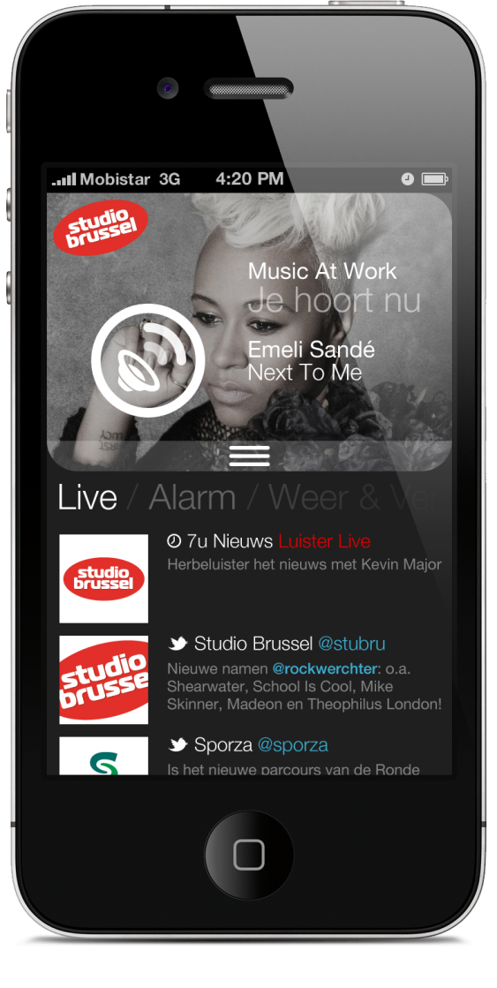
5. Reaching a future audience
Notes:
Different visual states based on context, needs, use
Extra functions: news, weather, alarm clock, traffic…

Slide 30
5. Reaching a future audience
Multiplatform radio
Radio = your guide
News is key
Wild Radio initiatives
Notes:
! Klik WRL logo voor clip !

Slide 31
Get to know VRT
Radio + http://radioplus.be
(public beta version)
www.vrt.be
www.stubru.be www.mnm.be
Notes:
Beta version is online, check it out at radioplus.be

